Slide 1

EXPERTISE/ PUBLIC PARTICIPATION
HM 216

Slide 2


People PLACE TECHNOLOGY
connections
Notes:
https://www.chinkyshukla.in/projects/jadugoda-the-nuclear-graveyard

Slide 3

‘…An overly narrow focus on decisions ignores the different ways in which problems come into being and are framed, and the different cultures in which knowledge is used and evaluated…as well as the complexly interacting factors involved in many issues…’
Sismondo, 181
Notes:
https://en.wikipedia.org/wiki/HIV/AIDS_activism#/media/File:Minnesota_AIDS_Project_-_HIV_Stigma_Stops_Here_-_Twin_Cities_Pride_Parade_(9180874836).jpg

Slide 4
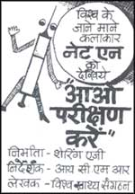
Title
‘Population Control’
Women’s Rights
In the 1980s, injectable, ‘long-acting’ contraceptives like Net-en and Norplant were introduced by American companies.
These were at the ‘cutting edge’ of birth control technologies, sold as such.
Across the world, these were mostly used on women from poor and marginalized communities.
Experiments for these new technologies were carried out on women in Third World countries like India, Bangladesh, Indonesia and Egypt.
Feminists from these countries mobilized against their use, conducting an international campaign.

Slide 5
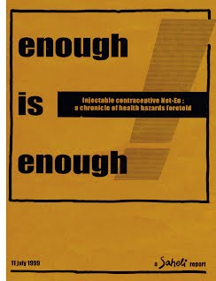
Experts as allies
The Net-en Campaign
‘… We tried to learn every aspect of the technology. This made us credible to talk to the scientific community and the officials. We wanted to show that we were not against technology and the very clear statement that was coming out was that, “ok, there are scientific developments but they should not be used against women or sought to prop up patriarchy”’
(Indu Agnihotri, CWDS; quoted in Nair & Kalarivayil, 2017)
Notes:
Smitha Nair and Rajesh Kalarivayil. ‘“Saved a Generation” Campaigns against Hazardous Contraceptives in India.’ Asian Journal of Social Science, 45, 2017.

Slide 6

Title:
CIVIC EPISTEMOLOGIESUt gravida eros e SHEILA JASANOFF, DESIGNS ON NATURE: SCIENCE AND DEMOCRACY IN EUROPE AND THE UNITED STATES, 2005

Slide 7

Civic Epistemologies
“The dimensions along which variations of knowledge politics occur include: public accountability and the basis for trusting the state, how states demonstrate their legitimacy, how knowledge is represented as neutral and objective, what counts as authoritative expertise, and the visibility and openness of expert bodies to public scrutiny.” (Haines, 2020)
Notes:
https://www.tandfonline.com/doi/full/10.1080/23299460.2020.1771145?src=recsys

Slide 8

the Chernobyl effect
BRITAIN, 1986- 2012
‘As the droplets of water fell from the sky, they carried with them the radionuclides – in particular, caesium-137, iodine-131 and strontium-90 – that had been dispersed from Chernobyl. It is estimated that 1% of the radiation released from the reactor fell on the UK. In an effort to prevent these radionuclides entering the food chain once they had settled on the upland soil, the ministry of agriculture, fisheries and food… ordered an immediate restriction on the movement and sale of sheep within the most affected areas – particularly north Wales, south-west Scotland, Northern Ireland and the Lake District, where the landscape is predominantly suited to grazing sheep. In total, almost 9,000 farms, and four million sheep, were placed under restriction.’
Notes:
Image: https://upload.wikimedia.org/wikipedia/commons/thumb/9/91/Sheep_with_lamb_in_Wales.jpg/512px-Sheep_with_lamb_in_Wales.jpg

Slide 9
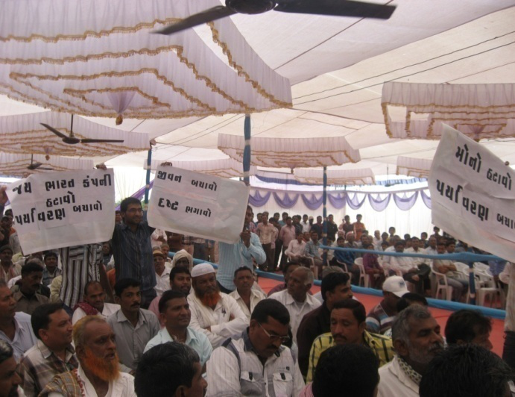
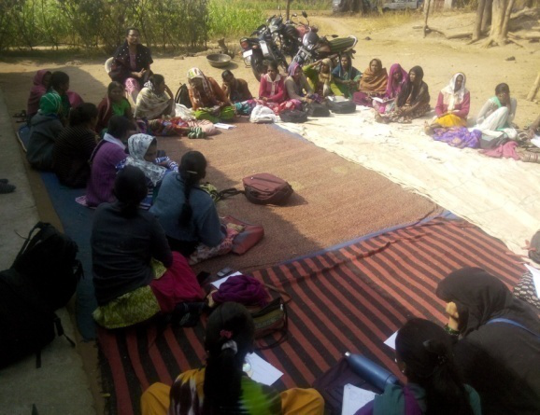
Deliberative DEMOCRACY
Public participation
‘public hearings’ on environmental issues
‘It is not “that an average citizen is able to design a nuclear reactor or a river dike, but . . . more is involved in designing large projects such as nuclear power stations and water management systems than is described in the engineers’ handbooks” (Bijker 2001).’
Notes:
Environmental Public Hearing | Paryavaran Mitra (Images)

Slide 10
CITIZEN SCIENCE
WHAT WOULD IT MEAN?

Slide 11

Citizen science network for the Amazon

Slide 12
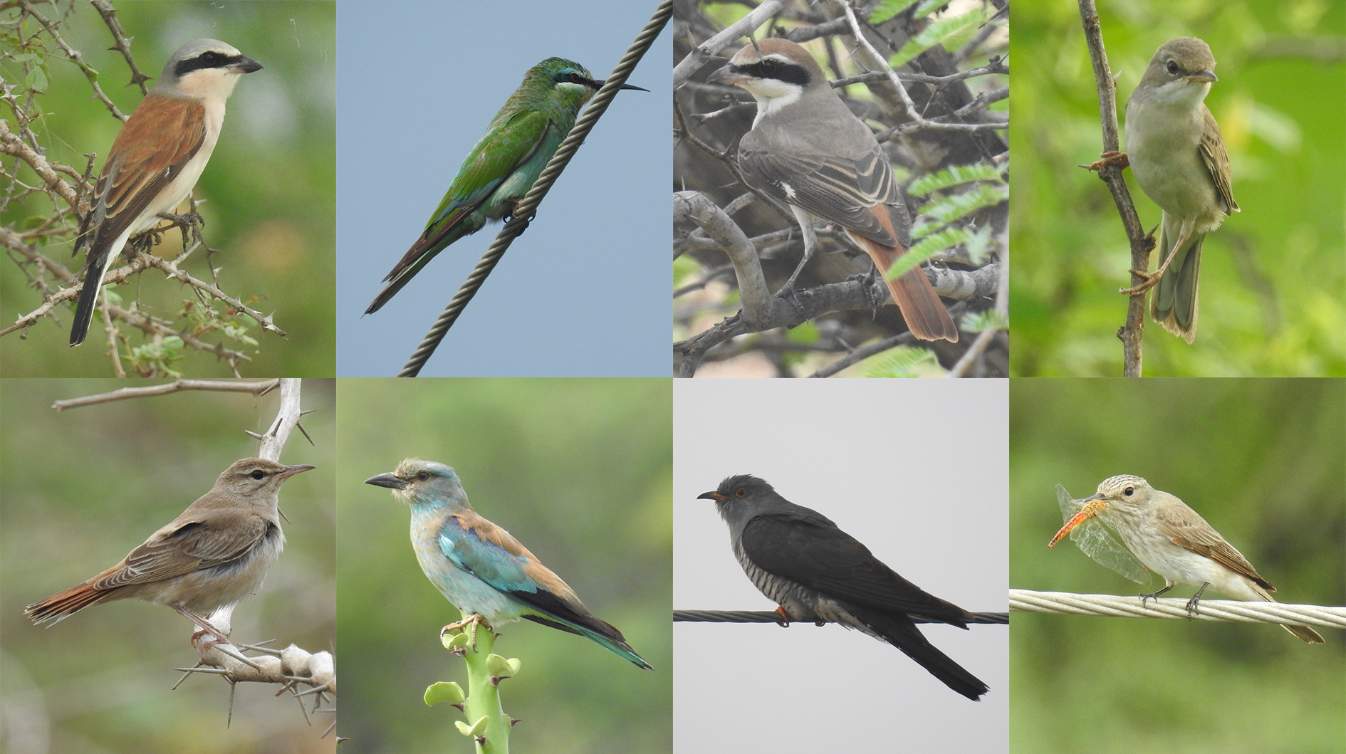
Migrant bird count, Kutch 2022

